Slide 1
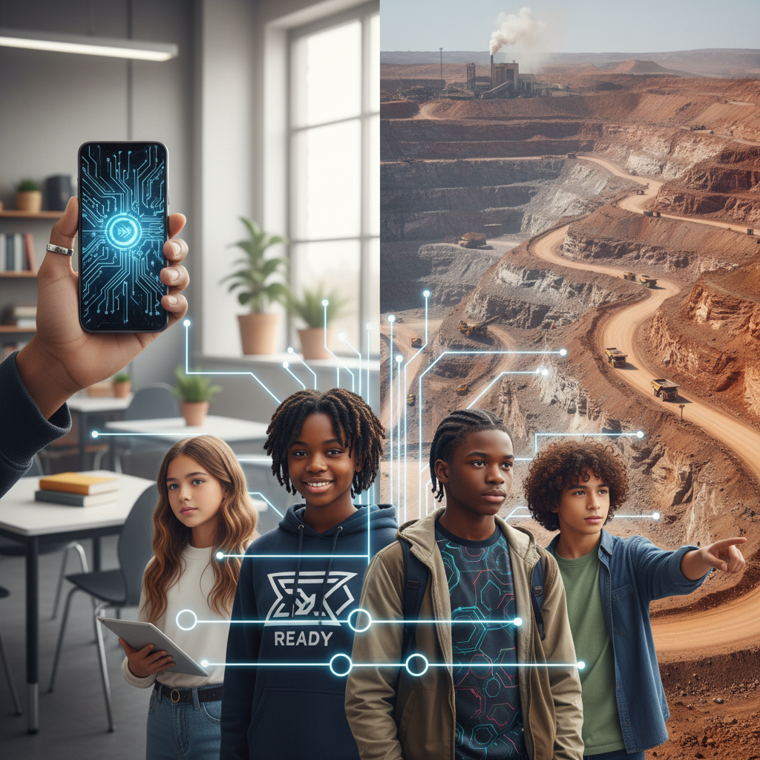
ModelIt!
Student Lesson
Your Phone's Dirty Secret
The Hidden Environmental Cost of the Device in Your Pocket
NGSS: MS-ESS3-3, MS-ESS3-4
8th Grade
1/9

Slide 2
What You Will Learn Today
Learning Goals
* Trace the lifecycle of a smartphone from raw materials to e-waste
* Model how increased demand for rare earth minerals affects Earth's systems
* Evaluate the environmental trade-offs of technology consumption
* Design solutions to minimize the environmental impact of electronics
Key Vocabulary
Rare Earth Minerals
A group of 17 metallic elements essential for modern electronics, found in limited locations
E-Waste
Discarded electronic devices that contain toxic and valuable materials
Resource Extraction
The process of removing raw materials from the Earth
Lifecycle Analysis
Studying the environmental impact of a product from creation to disposal
2/9

Slide 3
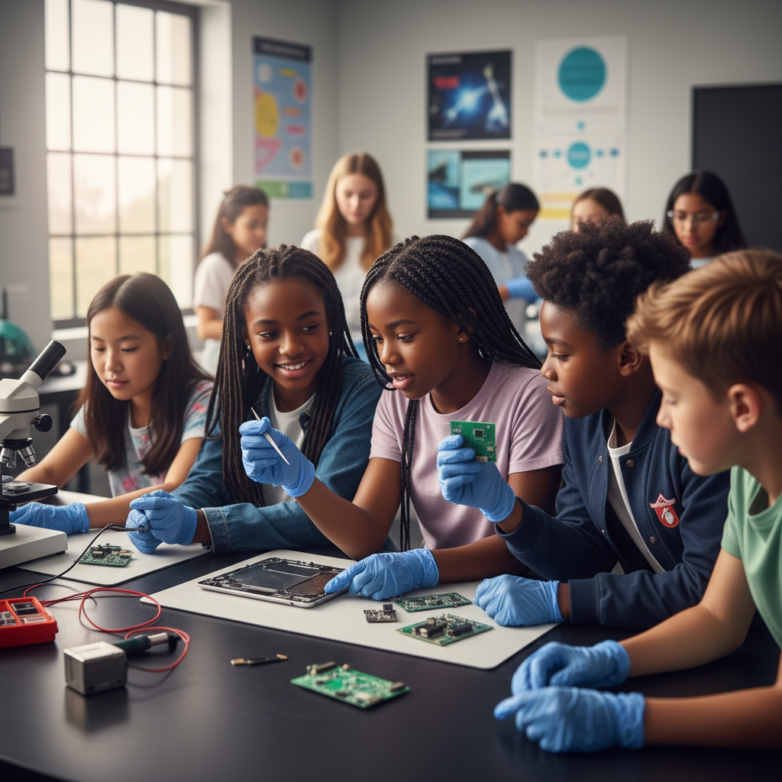
The Big Question
What is the true environmental cost of the phone in your pocket?
The Hidden Environmental Cost of the Device in Your Pocket. Today we'll build a MODEL to discover the answer!
3/9

Slide 4
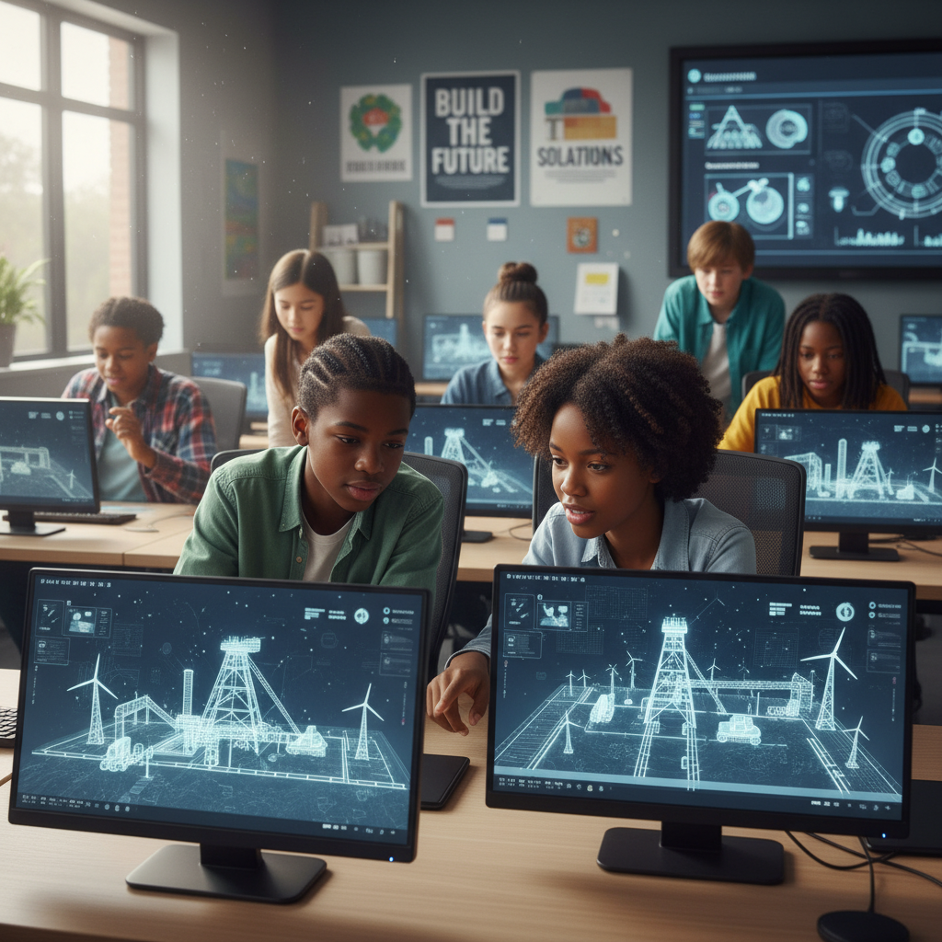
Today We Will Build a Model!
A model helps us understand complex systems!
1. LOCATE
Identify the COMPONENTS (parts) of the system
2. ESTABLISH
Connect them with RELATIONSHIPS (+ or -)
3. VISUALIZE
Build your model in ModelIt!
4. EVALUATE
Run SIMULATIONS to test scenarios
5. REVISE
Improve your model based on evidence
4/9

Slide 5

Activity 1: Sort the Components
Sort these components into EXTERNAL (inputs from outside) and INTERNAL (inside the system):
Your Components:
* Consumer Demand
* Mining Intensity
* Environmental Damage
* E-Waste Accumulation
Think: Which components can we control? Which happen on their own?
5/9

Slide 6
Activity 2: Connect with Arrows
Draw arrows to show HOW components affect each other:
(+) POSITIVE Relationship
When one goes UP, the other goes UP too
(-) NEGATIVE Relationship
When one goes UP, the other goes DOWN
Think About It:
When consumer demand for new phones increases, what do you think happens to mining intensity and environmental damage?
6/9

Slide 7
Activity 3: Run the Simulation!
Test these scenarios in ModelIt!
Current Trends
Set Consumer Demand and Mining Intensity to current real-world levels
Upgrade Every Year
Lock Consumer Demand to maximum — everyone gets a new phone annually
Circular Economy
Set Consumer Demand to 50% and add a recycling component
Watch the activity graphs change!
[ModelIt Platform Screenshot - Simulation Results Graph]
7/9

Slide 8
What Did We Discover?
Our Model Showed Us:
* A single smartphone contains over 30 different minerals from mines across the world
* Mining rare earth minerals generates toxic waste that contaminates water and soil
* Only about 20% of e-waste is properly recycled — the rest goes to landfills or developing countries
* Reducing demand (keeping phones longer) has a bigger impact than recycling alone
Answer: Every phone requires mining dozens of minerals from the Earth, creating environmental destruction. When billions of phones are discarded, the toxic e-waste accumulates faster than we can recycle it!
8/9

Slide 9

STEM Challenge: Design a Sustainable Phone Program
YOUR ENGINEERING MISSION
Design a school or community program that reduces the environmental impact of smartphone consumption.
The Challenge:
Your school district wants to reduce its technology footprint. Design a program that balances student access to technology with environmental responsibility.
Think Like an Engineer:
* How can you extend the useful life of electronic devices?
* What happens to phones when they're recycled vs. thrown away?
* Which stage of the phone's lifecycle creates the most environmental damage?
REAL CAREER CONNECTION: Environmental Engineers and Sustainability Consultants help companies reduce their environmental footprint and design greener products. They earn $70,000-$120,000/year. The skills you're using TODAY are the same ones they use on the job!
9/9

